Slide 1
MRI of Malignant Hepatic Tumors: Tips and Tricks
Rachel Schor-Bardach MD

Slide 2
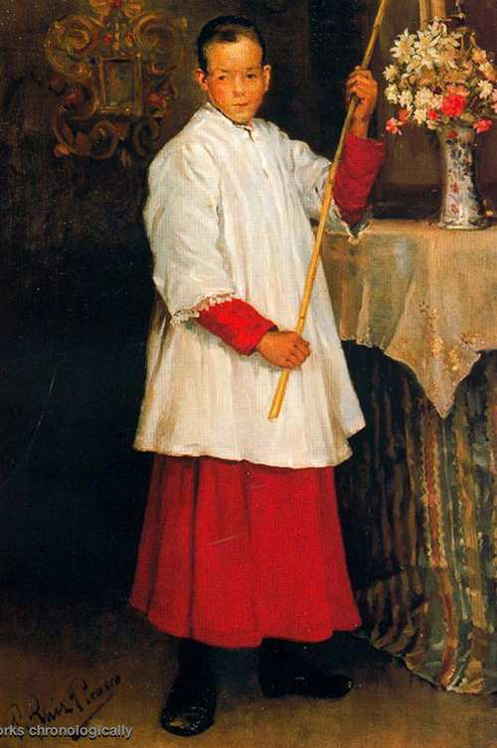
“An artist is only as good as his tools.” –Elaine Maurer, circa 1991
Pablo Ruiz y Picasso
1896
Wikiart.org

Slide 3
Overview
Basic MR protocol
Hepatocyte Specific Contrast Agents
Diffusion Weighted Imaging
Special populations
Fatty liver
Cirrhotic liver
Notes:
No disclosures

Slide 4
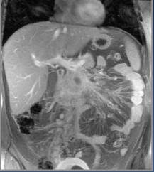
MRI- Basic liver protocol
Cor SSFSE T2w
Ax T2w FSE
Ax T1w Opposed phase imaging
T1w Dynamic Technique
at least pre, arterial, portal-venous,
equilibrium, delayed
- Hepatobiliary phase
Substractions
DWI- Ax
3D MRCP
Notes:
In and Out of phase -offers advantage over CT in presence of fatty liver
Post gad: -characterize known lesions -detect additional lesions
Hepatocyte Specific Contrast Agents -hypointese on delayed phase
DWI/ADC -Restricted diffusion - high signal intensity lesions with low ADC values -improved detection -increased conspicuity of subcm lesions
Lower spatial resolution than CT Improved soft tissue sensitivity/ increased soft tissue contrast: -detect subcm lesions

Slide 5
MRI- Basic liver protocol
Tailor the study protocol
Indication for the study
Pt’s medical history- malignancy, fatty liver etc
Previous studies
Carefully read the standard
sequences
T1FS pre

Slide 6
Hepatocyte-specific Contrast Agents
Specifically taken up by hepatocytes (OATPs)
Excreted into biliary tree (MRPs)
Biphasic enhancement pattern
Immediately after administration (similar to standard extracellular contrast agents)
Delayed, approximately 10-120 minutes after administration
Notes:
organic anion transporting polypeptides (OATPs) and excreted via multidrug resistance-associated proteins (MRPs) to bile canaliculi

Slide 7
HPB agents- Differences
Eovist® (Gadoxetate)
MultiHance® (Gadobenate Dimeglumine)
Chanyaputhipong et al. Int J Hepatology 2011
Notes:
MultiHance
95% renal excretion
3-5% biliary
Delayed imaging time 1-2 hours
Eovist
50% renal
50% biliary
10-60 minutes
Better delineation of biliary tree

Slide 8
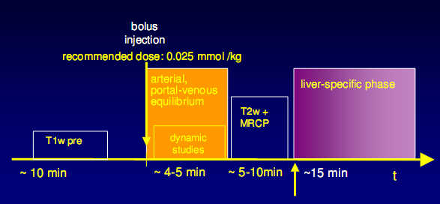
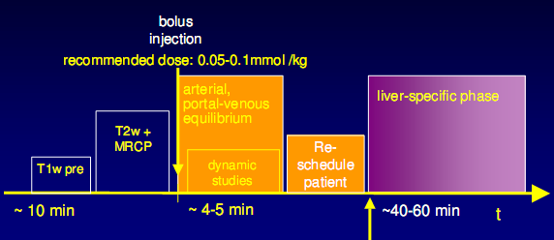
Exam protocol
Eovist
Multihance

Slide 9
HPB agents
Imaging patterns of HPB phase are divided into two categories:
hypo-intensity
hyper-/iso-intensity
Explained by OATP and MRP expression
Improved detection & characterization
Make sure there is biliary excretion on HPB phase!
Jeong et al Clin Mol Hepatol 2013

Slide 10
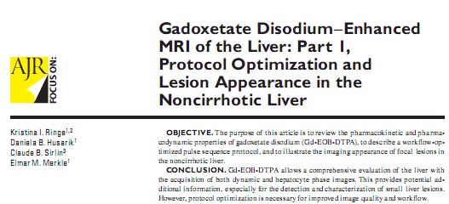
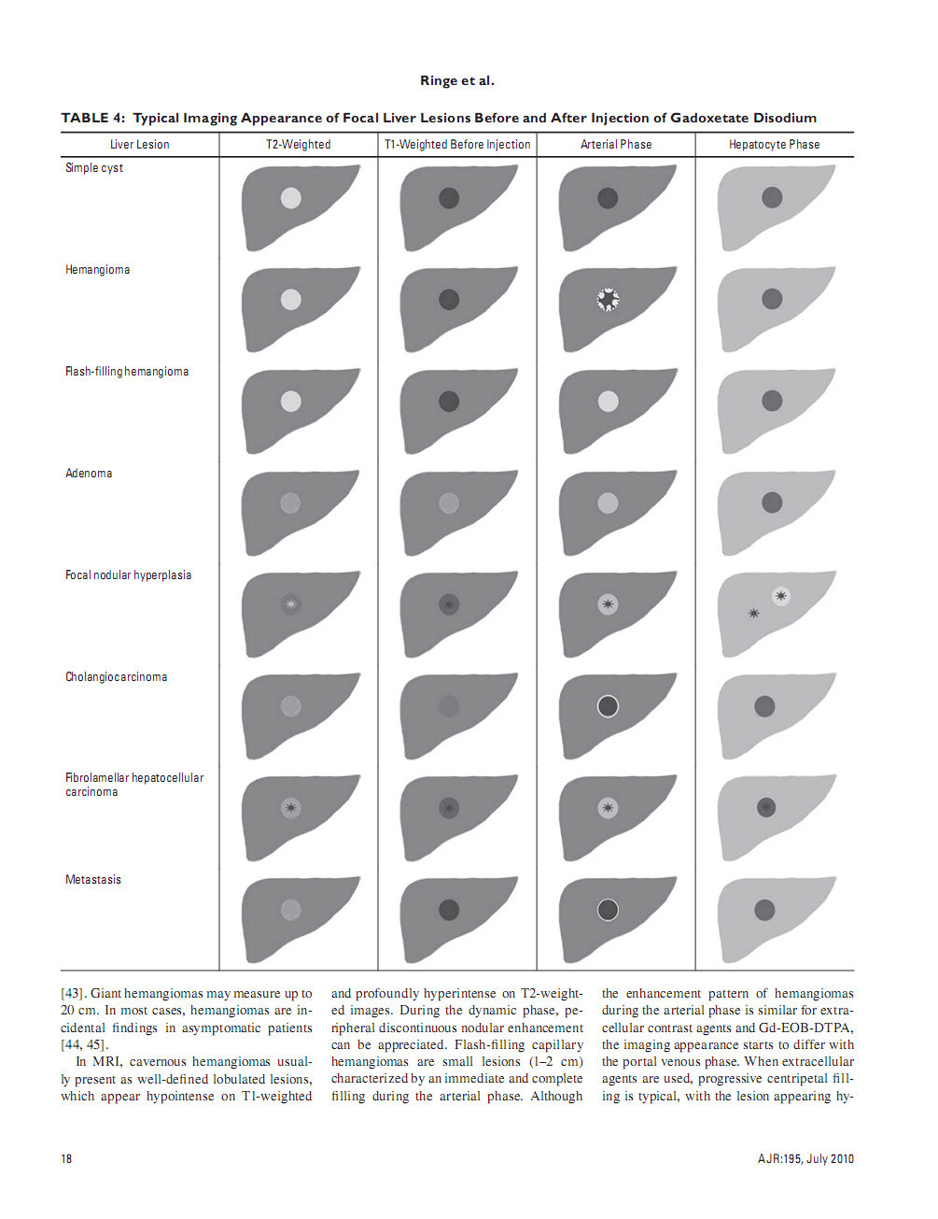
Ringe et al. AJR 2010

Slide 11
HPB agents- disadvantages
Poor image quality of early period (i.e. arterial phase) after administration of contrast agent.
ringing artifact-derived from a steep concentration and higher relaxivity of contrast
acute transient dyspnea- temporary, self-limiting roughly 10-20 seconds, may cause motion artifact
Multihance: additional delayed sequence
Notes:
Solution: dual arterial phase, slower injection rate, square matrix

Slide 12
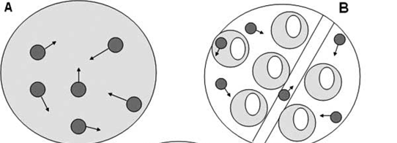
Diffusion-weighted MRI (DW-MRI)
Measures mobility of water molecules (Brownian motion) in tissues
Influenced by cellular environment
Monitors changes in cellularity
Normal
Tumor
Qayyum, RadioGraphics 2009

Slide 13
DW Imaging
Add useful qualitative and quantitative information to conventional imaging sequences
Increased conspicuity of subcm lesions
Acquired relatively quickly
A non-contrast technique
Notes:
(two breath hold acquisitions)

Slide 14
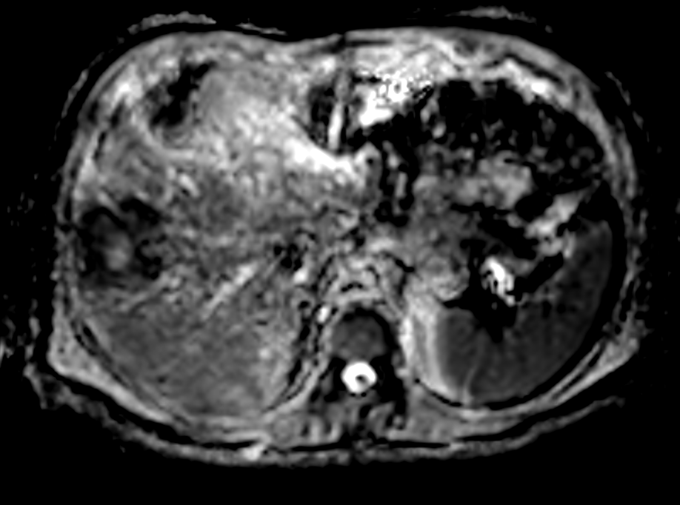
ADC
Quantitative analysis with the generation of apparent diffusion coefficient ADC value requiring at least two b-values (a low and a high b value)
appropriate b value selection must be tailored to the organ being assessed
B 0
B 500
ADC
Notes:
b value is the strength of the diffusion sensitizing gradient,
Its principle is based upon measuring the random motion of water into a voxel of tissue. It provides quantitative information
about tissue cellularity, depicting between normal parenchyma and malignant tissues/ apparent diffusion coefficient (ADC)
value is a measure of the magnitude of diffusion within a tissue.
The ADC values are automatically calculated by software
and displayed as a parametric map.

Slide 15
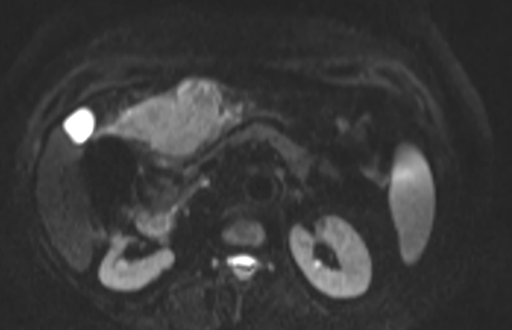
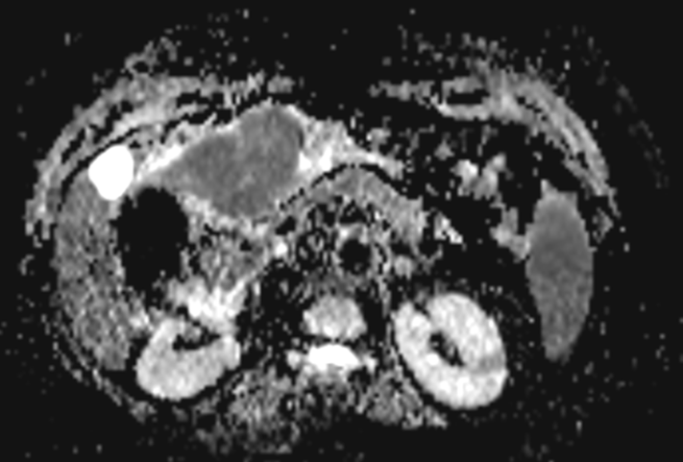
Apparent diffusion coefficient-ADC
DWI
ADC
DWI is quantified by calculating the apparent diffusion coefficient (ADC)
A low ADC value - tumor of dense cellularity
A high ADC value - necrotic or cystic lesion
Notes:
15

Slide 16
DWI limitations
Relatively low spatial resolution
Reduced SNR
Impaired by susceptibility artifacts caused by B1 inhomogeneities

Slide 17
DWI for focal liver lesions
DWI is highly sensitive for detection of liver metastases, especially for small lesions < 2 cm.
Combined DWI and CE T1WI yields the best performance
DWI is a reasonable alternative to CE MRI in patients who cannot receive GBCAs
DWI demonstrates moderate sensitivity for HCC detection. DWI should be used in combination with conventional MRI sequences
Lewis et al Magn Reson Imaging Clin N Am. 2014

Slide 18
Fatty liver
Chemotherapy –induced steatosis (Most common: 5-FU, irinotecan, tamoxifen, methotrexate )
Important to recognize- steatosis can limit metastases detection on CT
MR is markedly superior to MDCT (p<0.001) particularly for detection of small/subcentimeter lesions (p<0.004)
Kulemann V, Schima W, Tamandl D, et al. Preoperative detection of colorectal liver metastases in fatty liver: MDCT or MRI? Eur J Radiol 2011;79(2):e1–e6.

Slide 19
Cirrhotic liver
HPB Phase:
In most HCC: expression of OATP1B1/B3 and the MRP2 expression → influx of contrast agent is restricted and the excretion of contrast agent is enhanced→ HCCs appear hypointense
Regenerative or low-grade dysplastic nodules consist of functioning hepatocytes - have a normal biliary excretory system→ iso-intense
Tsuboyama et al. Radiology 2010

Slide 20
Cirrhotic liver
The combination of gadoxetic acid–enhanced MR imaging and DWI yielded better diagnostic accuracy and sensitivity in the detection of small (<2.0 cm) HCCs than each technique alone
Combined 92.4%; gadoxetic acid 81.4%; DW 78.8%; P = .001
The hyperintensity of solid masses on high-b-value DW imaging is highly indicative of HCC in patients with underlying chronic hepatitis or cirrhosis
Park et al. Radiology 2012

Slide 21
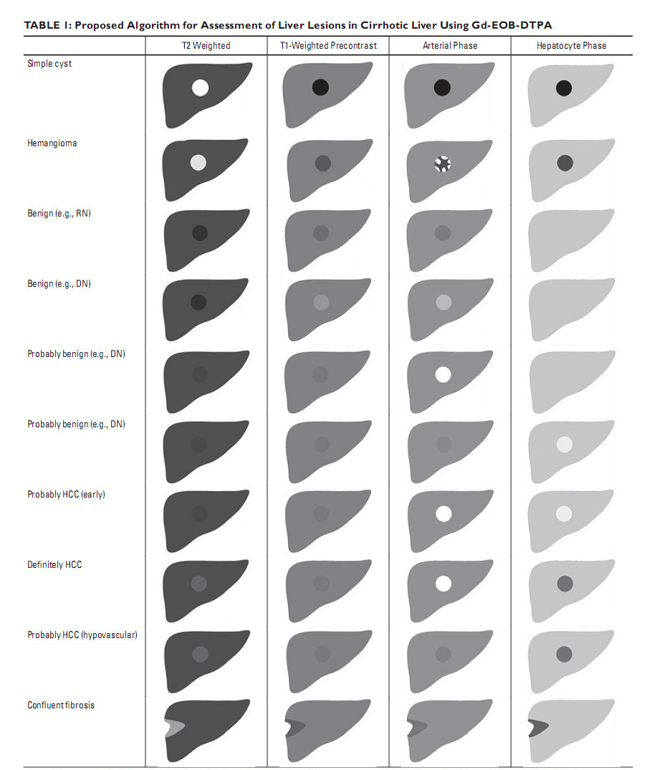
Cruite et al. AJR 2010

Slide 22
In Summary
Be familiar of your department ‘tools’
Tailor the protocol per clinical question
Consider HPB agent (especially if liver is cirrhotic or fatty)
Optimize your DWI sequence
Team work (technologists & radiologists)

Slide 23
Acknowledgment
Sheba Medical Center, Body service:
Dr. Yael Inbar
Prof. Sara Apter
Memorial Sloan Kettering Cancer Center, Body service:
Dr. Richard Do
Dr. Jeniffer Golia-Pernicka

Slide 24
Thank you!

